Slide 1
Able to Understanding REST API, API services in IBM and AWS Cloud.
Notes:
Title - The learning outcome
Subtitle - Duration

Slide 2
In this section, we will discuss:
Introduction to Application Programming Interface (API)
Common API examples
Types of API’s
Types of API protocols
What is a REST API?
API services in IBM and AWS Cloud
IBM API Management on Cloud
API management tools on AWS
Amazon API Gateway benefits
Notes:
Mention the parent topics one by one. This particular learning outcome has 4 parent topics.

Slide 3
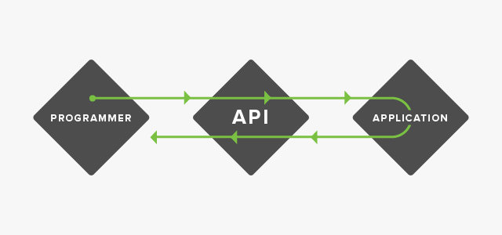
Introduction to Application Programming Interface (API)
API Concept
An application programming interface, or API, enables companies to open up their applications’ data and functionality to external third-party developers, business partners, and internal departments within their companies.
Image Source: https://media.sproutsocial.com/uploads/2015/04/API_defined3-02.png
Notes:
Left (White Color space):
Title - Parent Topic
Subtitle - Subtopic 1
Body Text - Description in bullets
Right (Grey Color Space):
Body Text - Relevant image (with source)/code snippet
Put reference links in Speaker Notes
Reference:
https://www.tutorialspoint.com/internet_technologies/internet_overview.htm/

Slide 4
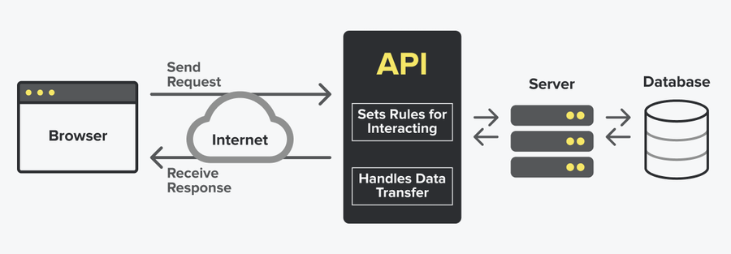
Introduction to Application Programming Interface (API)
How an API works
A client application initiates an API call to retrieve information—also known as a request. This request is processed from an application to the web server via the API’s Uniform Resource Identifier (URI) and includes a request verb, headers, and sometimes, a request body.
After receiving a valid request, the API makes a call to the external program or web server.
Image Source: https://www.datocms-assets.com/48401/1627660998-api-diagram.png?fit=max&w=900
Notes:
Left (White Color space):
Title - Parent Topic
Subtitle - Subtopic 1
Body Text - Description in bullets
Right (Grey Color Space):
Body Text - Relevant image (with source)/code snippet
Put reference links in Speaker Notes
Reference:
https://www.tutorialspoint.com/internet_technologies/internet_overview.htm/

Slide 5
Introduction to Application Programming Interface (API)
How an API works
The server sends a response to the API with the requested information.
The API transfers the data to the initial requesting application.
Image Source: https://www.datocms-assets.com/48401/1627660998-api-diagram.png?fit=max&w=900
Notes:
Left (White Color space):
Title - Parent Topic
Subtitle - Subtopic 1
Body Text - Description in bullets
Right (Grey Color Space):
Body Text - Relevant image (with source)/code snippet
Put reference links in Speaker Notes
Reference:
https://www.tutorialspoint.com/internet_technologies/internet_overview.htm/

Slide 6
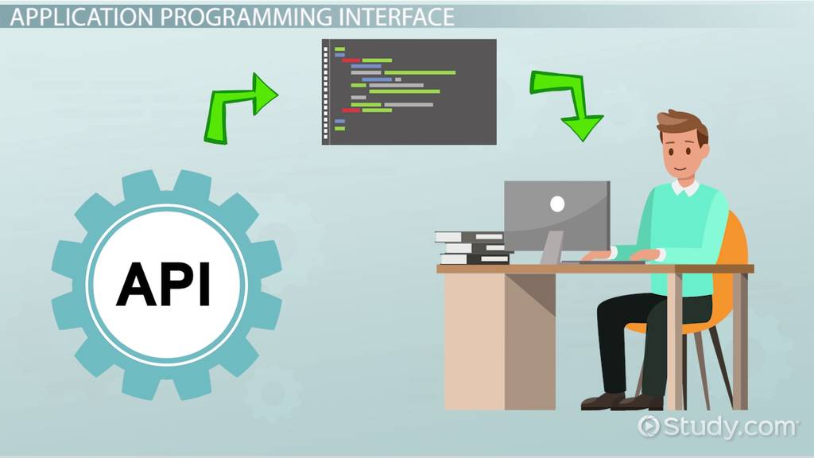
Introduction to Application Programming Interface (API)
Why we need APIs
Improved collaboration
Easier innovation
Data monetization
Added security
Image Source: https://study.com/cimages/videopreview/kg7jeue1w3.jpg
Notes:
Left (White Color space):
Title - Parent Topic
Subtitle - Subtopic 1
Body Text - Description in bullets
Right (Grey Color Space):
Body Text - Relevant image (with source)/code snippet
Put reference links in Speaker Notes
Reference:
https://www.tutorialspoint.com/internet_technologies/internet_overview.htm/

Slide 7
Why we need APIs
Improved collaboration
The average enterprise uses almost 1,200 cloud applications (link resides outside of IBM), many of which are disconnected.
APIs enable integration so that these platforms and apps can seamlessly communicate with one another.
Image Source: https://study.com/cimages/videopreview/kg7jeue1w3.jpg
Notes:
This slide talks about the case if we have to divide a subtopic further.
Title Box - Parent Topic
Subtitle box - Sub Topic
Body Text - Subtopic divisions (Subtopics of subtopics)

Slide 8
Why we need APIs
Easier innovation
APIs offer flexibility, allowing companies to make connections with new business partners, offer new services to their existing market, and, ultimately, access new markets that can generate massive returns and drive digital transformation.
Image Source:
Image Source: https://study.com/cimages/videopreview/kg7jeue1w3.jpg
Notes:
This slide talks about the case if we have to divide a subtopic further.
Title Box - Parent Topic
Subtitle box - Sub Topic
Body Text - Subtopic divisions (Subtopics of subtopics)

Slide 9
Why we need APIs
Data monetization
Many companies choose to offer APIs for free, at least initially, so that they can build an audience of developers around their brand and forge relationships with potential business partners.
However, if the API grants access to valuable digital assets, you can monetize it by selling access
Image Source:
Image Source: https://study.com/cimages/videopreview/kg7jeue1w3.jpg
Notes:
This slide talks about the case if we have to divide a subtopic further.
Title Box - Parent Topic
Subtitle box - Sub Topic
Body Text - Subtopic divisions (Subtopics of subtopics)

Slide 10
Why we need APIs
Added security
As noted above, APIs create an added layer of protection between your data and a server.
Developers can further strengthen API security by using tokens, signatures, and Transport Layer Security (TLS) encryption; by implementing API gateways to manage and authenticate traffic; and by practicing effective API management.
Image Source:
Image Source: https://study.com/cimages/videopreview/kg7jeue1w3.jpg
Notes:
This slide talks about the case if we have to divide a subtopic further.
Title Box - Parent Topic
Subtitle box - Sub Topic
Body Text - Subtopic divisions (Subtopics of subtopics)

Slide 11
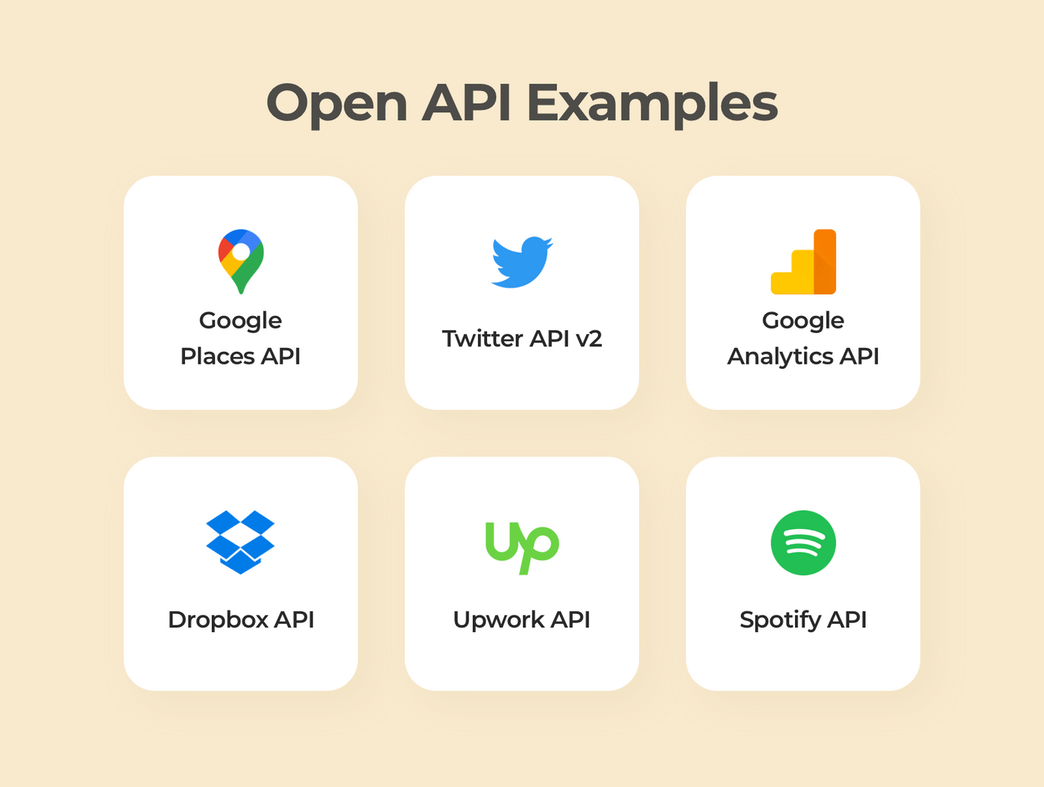
Introduction to Application Programming Interface (API)
Common API examples
Universal logins
Third-party payment processing
Travel booking comparisons
Google Maps
Twitter
Image Source: https://www.cleveroad.com/images/article-previews/fcdbb99f20231e6e2cc1c9ad4fc24b628b9e7c39066980451b2e88d5a10ffa29.png
Notes:
Left (White Color space):
Title - Parent Topic
Subtitle - Subtopic 1
Body Text - Description in bullets
Right (Grey Color Space):
Body Text - Relevant image (with source)/code snippet
Put reference links in Speaker Notes
Reference:
https://www.tutorialspoint.com/internet_technologies/internet_overview.htm/

Slide 12
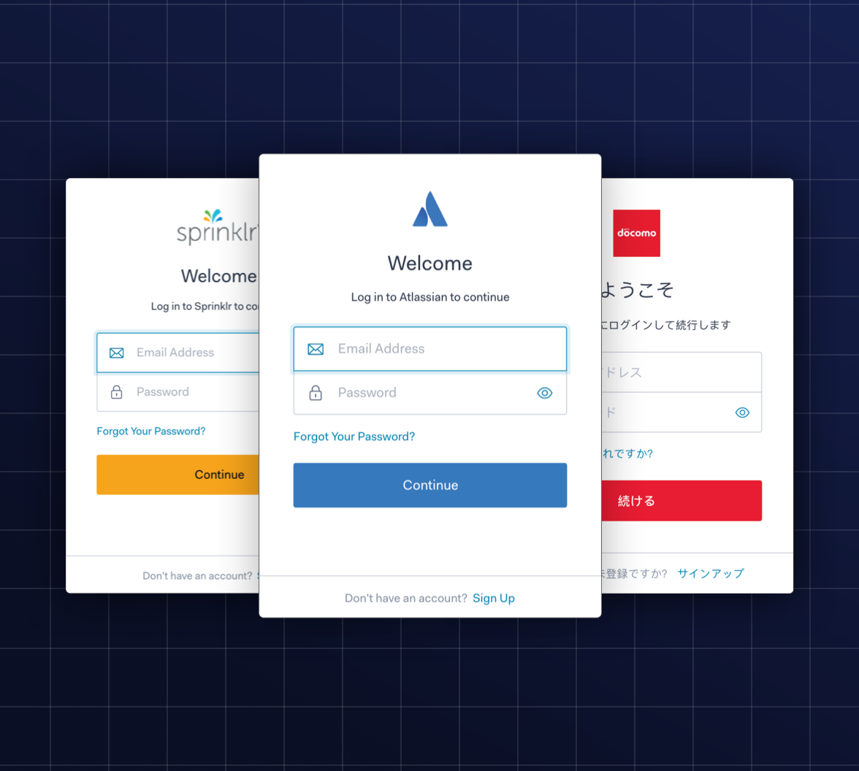
Common API examples
Universal logins
A popular API example is the function that enables people to log in to websites by using their Facebook, Twitter, or Google profile login details.
Image Source: https://images.ctfassets.net/23aumh6u8s0i/6aX7NoUXm3nRWuPDubQ9wH/15a58bffd6d01eb64c85e028391fa35f/universal-login
Notes:
Continuing from the last slide:
Title - Subtopic
Subtitle - Subtopic of Subtopic
Body - Description

Slide 13
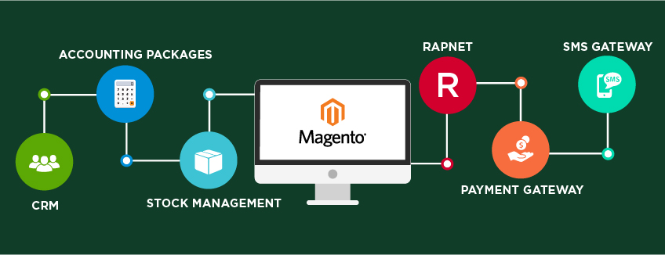
Common API examples
Third-party payment processing
For example, the now-ubiquitous "Pay with PayPal" function you see on ecommerce websites works through an API.
This allows people to pay for products online without exposing any sensitive data or granting access to unauthorized individuals.
Image Source: http://www.eviaglobal.com/images/Magento-API-Integration.jpg
Notes:
Continuing from the last slide:
Title - Subtopic
Subtitle - Subtopic of Subtopic
Body - Description

Slide 14

Common API examples
Travel booking comparisons
Travel booking sites aggregate thousands of flights, showcasing the cheapest options for every date and destination.
This service is made possible through APIs that provide application users with access to the latest information about availability from hotels and airlines.
Image Source: https://www.amarinfotech.com/wp-content/uploads/2020/09/Best-Flight-API-Provider-in-market-2020-2021.jpg
Notes:
Continuing from the last slide:
Title - Subtopic
Subtitle - Subtopic of Subtopic
Body - Description

Slide 15

Common API examples
Google Maps
One of the most common examples of a good API is the Google Maps service.
In addition to the core APIs that display static or interactive maps, the app utilizes other APIs and features to provide users with directions or points of interest.
Image Source: https://softauthor.com/wp-content/uploads/2020/05/what-is-google-maps.jpg
Notes:
Continuing from the last slide:
Title - Subtopic
Subtitle - Subtopic of Subtopic
Body - Description

Slide 16
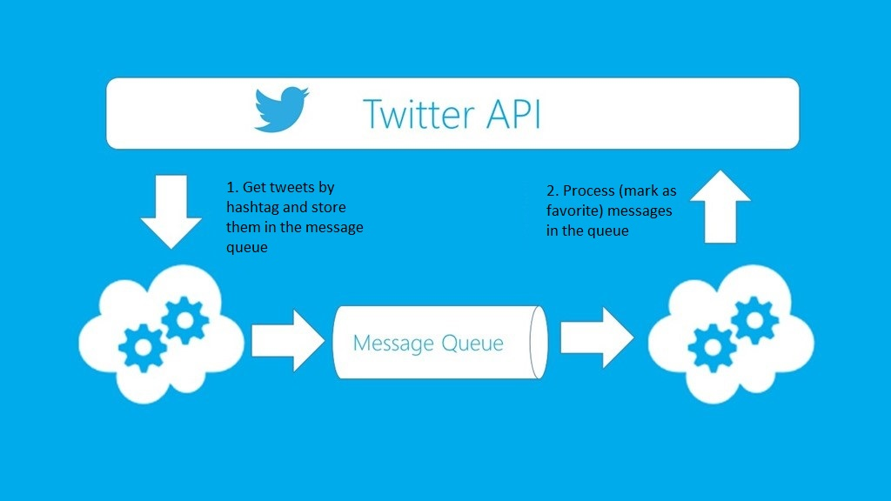
Common API examples
Twitter
Each Tweet contains descriptive core attributes, including an author, a unique ID, a message, a timestamp when it was posted, and geolocation metadata.
Twitter makes public Tweets and replies available to developers and allows developers to post Tweets via the company's API.
Image Source: https://nextgennewmedia.com/wp-content/uploads/2018/02/twitter_api.png
Notes:
Continuing from the last slide:
Title - Subtopic
Subtitle - Subtopic of Subtopic
Body - Description

Slide 17
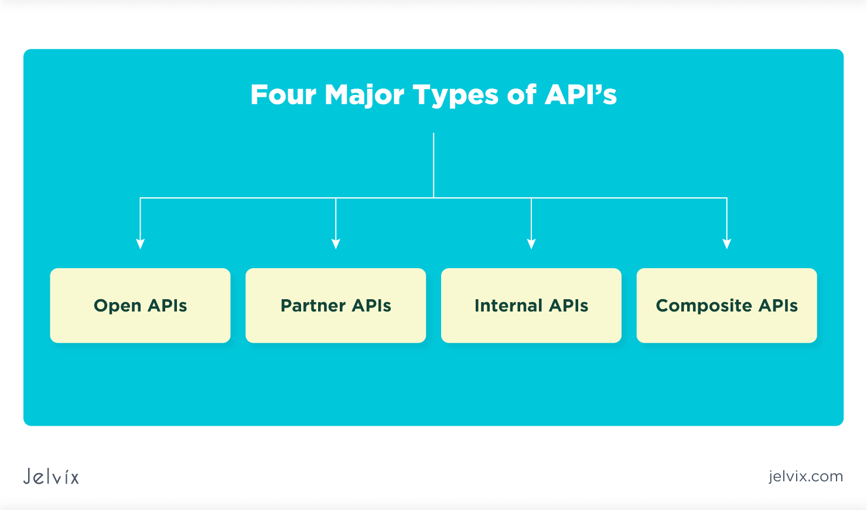
Introduction to Application Programming Interface (API)
Types of APIs
Open APIs
Partner APIs
Internal APIs
Composite APIs
Image Source: https://jelvix.com/wp-content/uploads/2021/02/types-of-api.png
Notes:
Left (White Color space):
Title - Parent Topic
Subtitle - Subtopic 1
Body Text - Description in bullets
Right (Grey Color Space):
Body Text - Relevant image (with source)/code snippet
Put reference links in Speaker Notes
Reference:
https://www.tutorialspoint.com/internet_technologies/internet_overview.htm/

Slide 18
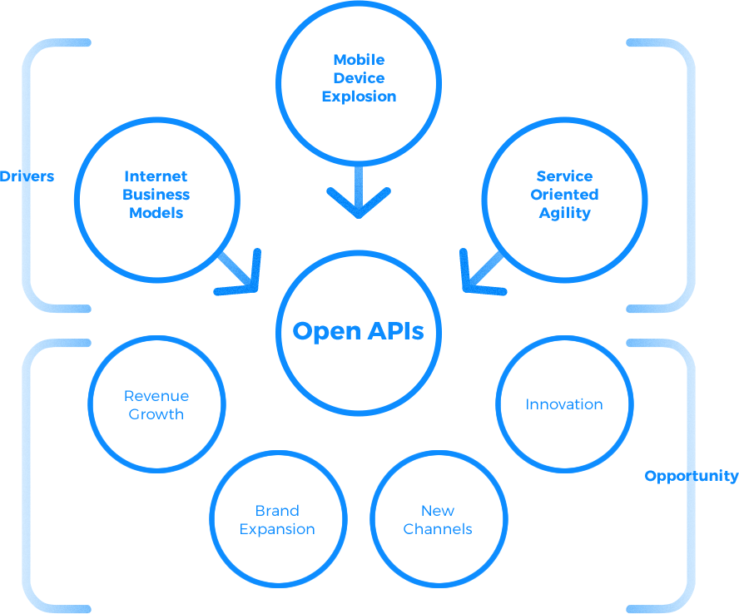
Types of APIs
Open APIs
Open APIs are open source application programming interfaces you can access with the HTTP protocol.
Also known as public APIs, they have defined API endpoints and request and response formats.
Image Source:https://www.consekense.com/img/confluenx/1.png
Notes:
Left (White Color space):
Title - Parent Topic
Subtitle - Subtopic 1
Body Text - Description in bullets
Right (Grey Color Space):
Body Text - Relevant image (with source)/code snippet
Put reference links in Speaker Notes
Reference:
https://www.tutorialspoint.com/internet_technologies/internet_overview.htm/

Slide 19
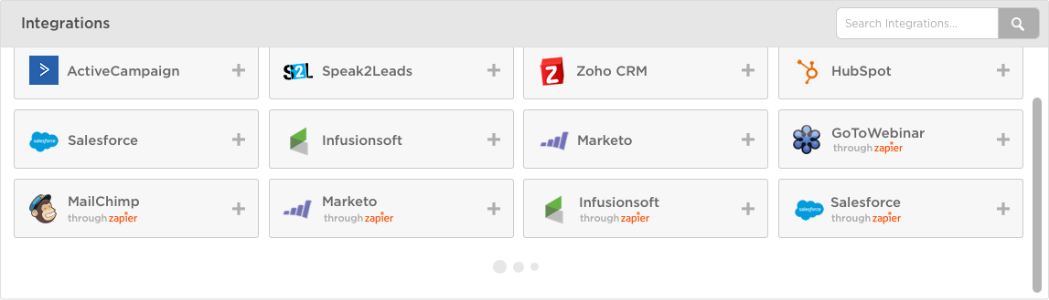
Types of APIs
Partner APIs
Partner APIs are application programming interfaces exposed to or by strategic business partners.
Typically, developers can access these APIs in self-service mode through a public API developer portal.
Image Source: https://cdn.zapier.com/storage/photos/6c1955e7660ff21d7fbc2afc606ef211_2.png
Notes:
Left (White Color space):
Title - Parent Topic
Subtitle - Subtopic 1
Body Text - Description in bullets
Right (Grey Color Space):
Body Text - Relevant image (with source)/code snippet
Put reference links in Speaker Notes
Reference:
https://www.tutorialspoint.com/internet_technologies/internet_overview.htm/

Slide 20
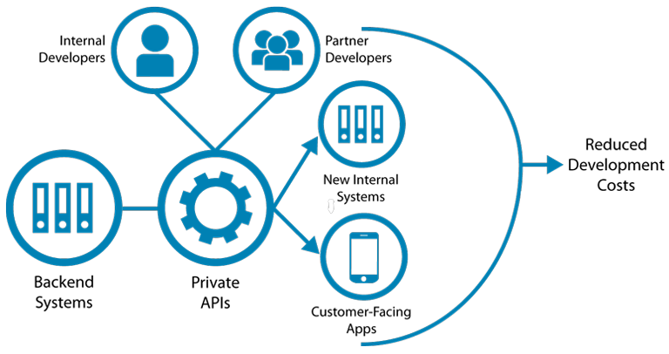
Types of APIs
Internal APIs
Internal APIs are application programming interfaces that remain hidden from external users.
These private APIs aren't available for users outside of the company and are instead intended to improve productivity and communication across different internal development teams.
Image Source: https://blog.restcase.com/content/images/2016/12/Private-APIs-v5.png
Notes:
Left (White Color space):
Title - Parent Topic
Subtitle - Subtopic 1
Body Text - Description in bullets
Right (Grey Color Space):
Body Text - Relevant image (with source)/code snippet
Put reference links in Speaker Notes
Reference:
https://www.tutorialspoint.com/internet_technologies/internet_overview.htm/

Slide 21
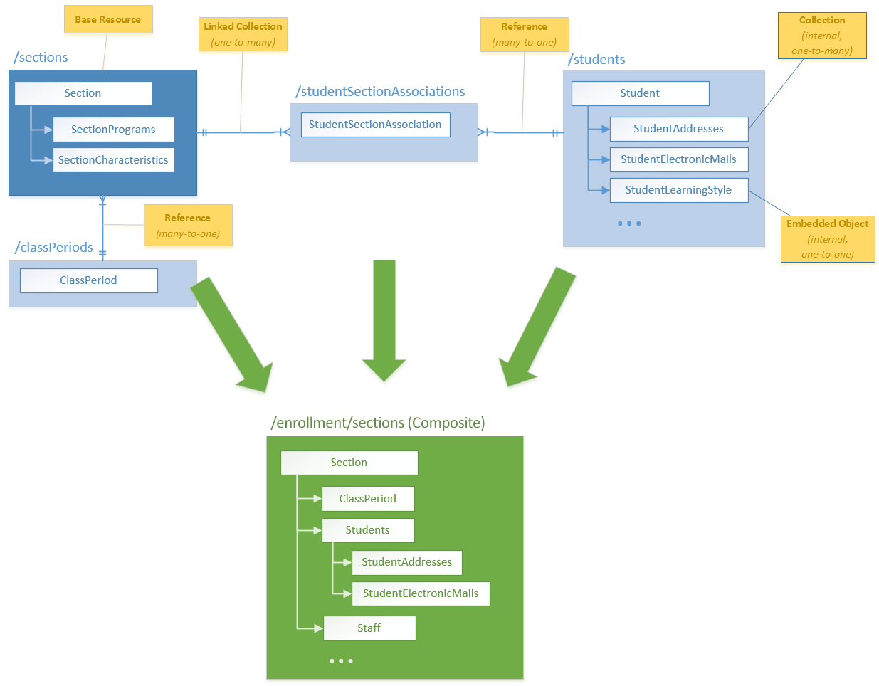
Types of APIs
Composite APIs
Composite APIs combine multiple data or service APIs.
These services allow developers to access several endpoints in a single call.
Composite APIs are useful in microservices architecture where performing a single task may require information from several sources.
Image Source: https://techdocs.ed-fi.org/download/attachments/21007509/Sample-Composite.png?version=2&modificationDate=1467143187207&api=v2
Notes:
Left (White Color space):
Title - Parent Topic
Subtitle - Subtopic 1
Body Text - Description in bullets
Right (Grey Color Space):
Body Text - Relevant image (with source)/code snippet
Put reference links in Speaker Notes
Reference:
https://www.tutorialspoint.com/internet_technologies/internet_overview.htm/

Slide 22
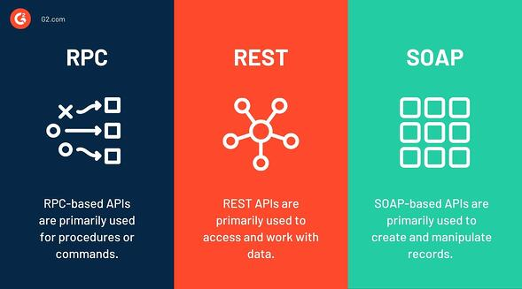
Introduction to Application Programming Interface (API)
Types of API protocols
SOAP (Simple Object Access Protocol)
XML-RPC
JSON-RPC
REST (Representational State Transfer)
Image Source: https://learn.g2.com/hs-fs/hubfs/Types%20of%20API-1.jpg?width=590&name=Types%20of%20API-1.jpg
Notes:
Left (White Color space):
Title - Parent Topic
Subtitle - Subtopic 1
Body Text - Description in bullets
Right (Grey Color Space):
Body Text - Relevant image (with source)/code snippet
Put reference links in Speaker Notes
Reference:
https://www.tutorialspoint.com/internet_technologies/internet_overview.htm/

Slide 23
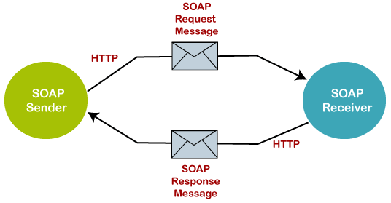
Types of API protocols
SOAP (Simple Object Access Protocol)
SOAP is an API protocol built with XML, enabling users to send and receive data through SMTP and HTTP.
With SOAP APIs, it is easier to share information between apps or software components that are running in different environments or written in different languages.
Image Source: https://static.javatpoint.com/tutorial/soapui/images/soap-and-rest-web-services.png
Notes:
Left (White Color space):
Title - Parent Topic
Subtitle - Subtopic 1
Body Text - Description in bullets
Right (Grey Color Space):
Body Text - Relevant image (with source)/code snippet
Put reference links in Speaker Notes
Reference:
https://www.tutorialspoint.com/internet_technologies/internet_overview.htm/

Slide 24
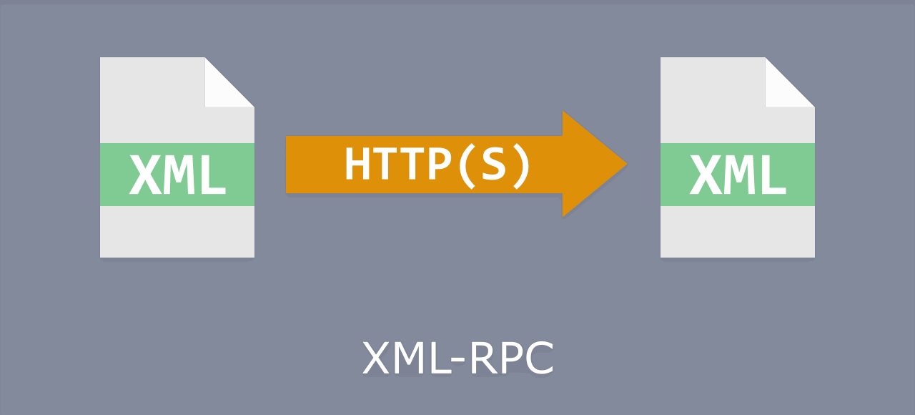
Types of API protocols
XML-RPC
XML-RPC is a protocol that relies on a specific format of XML to transfer data, whereas SOAP uses a proprietary XML format.
XML-RPC is older than SOAP, but much simpler, and relatively lightweight in that it uses minimum bandwidth.
Image Source: https://cdn.drlinkcheck.com/blog/xml-rpc.png
Notes:
Left (White Color space):
Title - Parent Topic
Subtitle - Subtopic 1
Body Text - Description in bullets
Right (Grey Color Space):
Body Text - Relevant image (with source)/code snippet
Put reference links in Speaker Notes
Reference:
https://www.tutorialspoint.com/internet_technologies/internet_overview.htm/

Slide 25
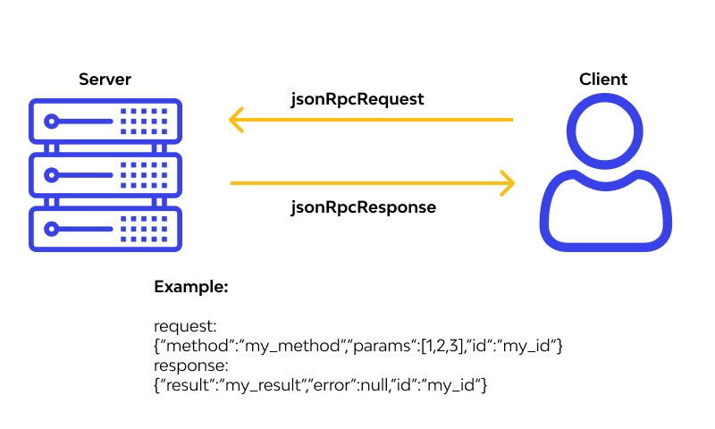
Types of API protocols
JSON-RPC
JSON-RPC is a protocol similar to XML-RPC, as they are both remote procedure calls (RPCs), but this one uses JSON instead of XML format to transfer data.
Both protocols are simple.
While calls may contain multiple parameters, they only expect one result.
Image Source: https://assets.website-files.com/5ff66329429d880392f6cba2/61b76e7fdf48bbef0026f39a_JSON%20works.png
Notes:
Left (White Color space):
Title - Parent Topic
Subtitle - Subtopic 1
Body Text - Description in bullets
Right (Grey Color Space):
Body Text - Relevant image (with source)/code snippet
Put reference links in Speaker Notes
Reference:
https://www.tutorialspoint.com/internet_technologies/internet_overview.htm/

Slide 26
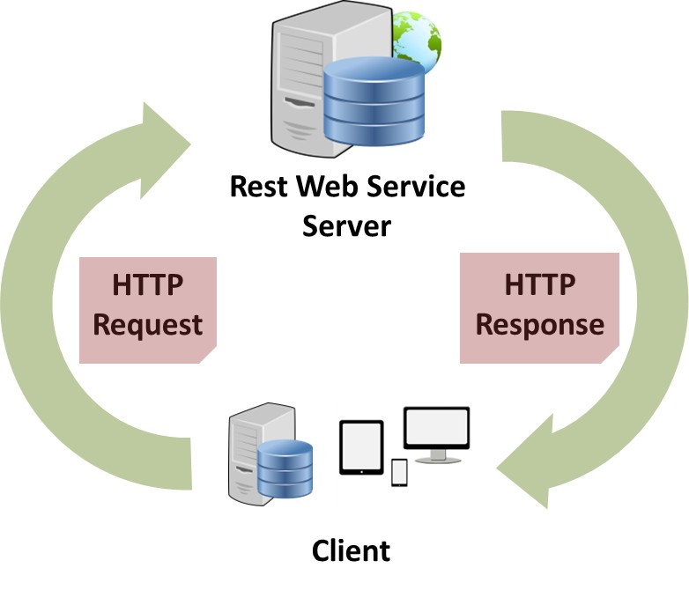
Types of API protocols
REST (Representational State Transfer)
REST is a set of web API architecture principles, which means there are no official standards (unlike those with a protocol).
To be a REST API (also known as a RESTful API), the interface must adhere to certain architectural constraints.
Image Source: https://miro.medium.com/max/782/1*EbBD6IXvf3o-YegUvRB_IA.jpeg
Notes:
Left (White Color space):
Title - Parent Topic
Subtitle - Subtopic 1
Body Text - Description in bullets
Right (Grey Color Space):
Body Text - Relevant image (with source)/code snippet
Put reference links in Speaker Notes
Reference:
https://www.tutorialspoint.com/internet_technologies/internet_overview.htm/

Slide 27
Introduction to REST API
REST (Representational State Transfer)
An API, or application programming interface, is a set of rules that define how applications or devices can connect to and communicate with each other.
A REST API is an API that conforms to the design principles of the REST, or representational state transfer architectural style.
Image Source:
Image Source: https://miro.medium.com/max/782/1*EbBD6IXvf3o-YegUvRB_IA.jpeg
Notes:
Left (White Color space):
Title - Parent Topic
Subtitle - Subtopic 1
Body Text - Description in bullets
Right (Grey Color Space):
Body Text - Relevant image (with source)/code snippet
Put reference links in Speaker Notes
Reference:
https://www.tutorialspoint.com/internet_technologies/internet_overview.htm/

Slide 28
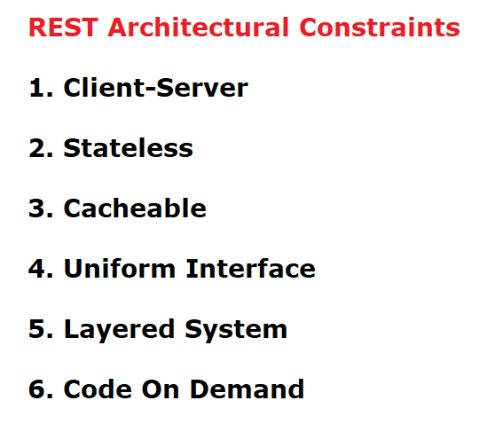
Introduction to REST API
REST design principles
Uniform interface
Client-server decoupling
Statelessness
Cacheability
Layered system architecture
Code on demand
Image Source: https://3.bp.blogspot.com/-hePTSHDMocA/Wy0LgvaeOmI/AAAAAAAACh8/4dLaq8Bw1jw4iLNTX_k3fhliYsGdA49GQCLcBGAs/s1600/REST%2BArchitectural%2BConstraints.png
Notes:
Left (White Color space):
Title - Parent Topic
Subtitle - Subtopic 1
Body Text - Description in bullets
Right (Grey Color Space):
Body Text - Relevant image (with source)/code snippet
Put reference links in Speaker Notes
Reference:
https://www.tutorialspoint.com/internet_technologies/internet_overview.htm/

Slide 29
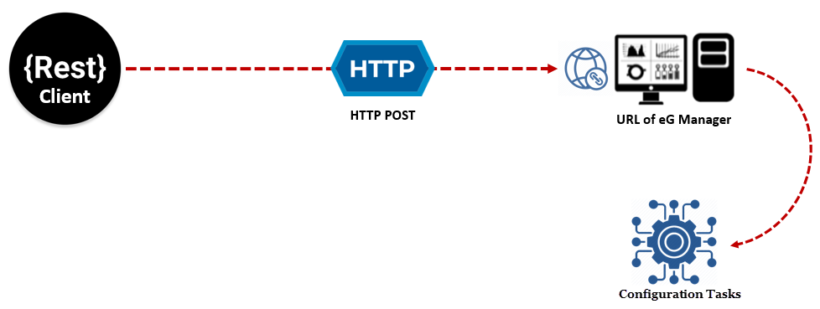
Introduction to REST API
How REST APIs work
REST APIs communicate via HTTP requests to perform standard database functions like creating, reading, updating, and deleting records (also known as CRUD) within a resource.
For example, a REST API would use a GET request to retrieve a record, a POST request to create one, a PUT request to update a record, and a DELETE request to delete one.
Image Source: https://www.eginnovations.com/documentation/Resources/Images/eGRESTAPI/RESTAPIWork.png
Notes:
Left (White Color space):
Title - Parent Topic
Subtitle - Subtopic 1
Body Text - Description in bullets
Right (Grey Color Space):
Body Text - Relevant image (with source)/code snippet
Put reference links in Speaker Notes
Reference:
https://www.tutorialspoint.com/internet_technologies/internet_overview.htm/

Slide 30
Introduction to REST API
How REST APIs work
All HTTP methods can be used in API calls.
A well-designed REST API is similar to a website running in a web browser with built-in HTTP functionality.
Image Source: https://www.eginnovations.com/documentation/Resources/Images/eGRESTAPI/RESTAPIWork.png
Notes:
Left (White Color space):
Title - Parent Topic
Subtitle - Subtopic 1
Body Text - Description in bullets
Right (Grey Color Space):
Body Text - Relevant image (with source)/code snippet
Put reference links in Speaker Notes
Reference:
https://www.tutorialspoint.com/internet_technologies/internet_overview.htm/

Slide 31
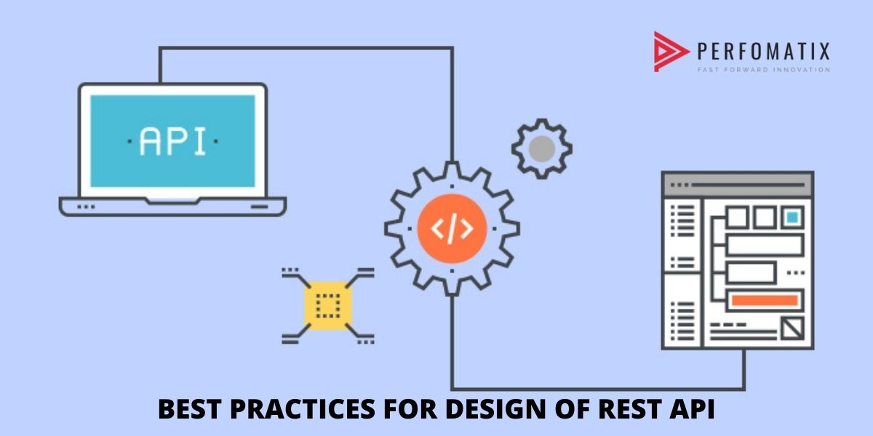
Introduction to REST API
REST API best practices
Although flexibility is a big advantage of REST API design, that same flexibility makes it easy to design an API that’s broken or performs poorly.
For this reason, professional developers share best practices in REST API specifications.
Image Source: https://www.perfomatix.com/wp-content/uploads/2020/09/Rest-API-best-practices.jpg
Notes:
Left (White Color space):
Title - Parent Topic
Subtitle - Subtopic 1
Body Text - Description in bullets
Right (Grey Color Space):
Body Text - Relevant image (with source)/code snippet
Put reference links in Speaker Notes
Reference:
https://www.tutorialspoint.com/internet_technologies/internet_overview.htm/

Slide 32
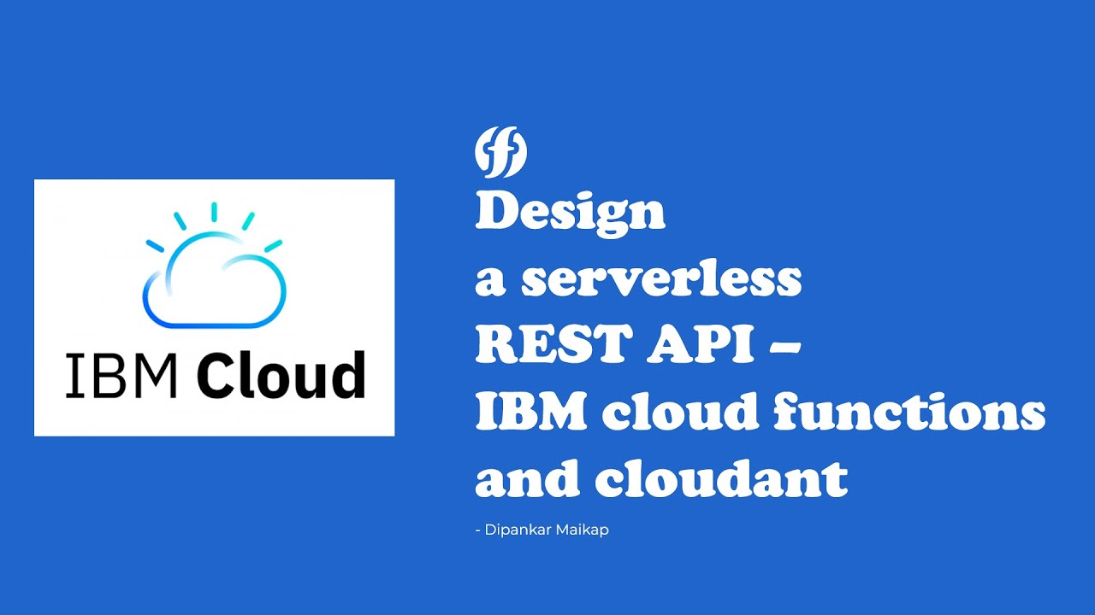
Introduction to REST API
REST APIs and IBM Cloud
The benefits of REST APIs mean that they’ll continue to be an integral part of the software development process, especially as the demand for better customer experiences and more applications impacts business and IT operations.
Image Source: https://i.ytimg.com/vi/bFbO1Pw_I_Y/maxresdefault.jpg
Notes:
Left (White Color space):
Title - Parent Topic
Subtitle - Subtopic 1
Body Text - Description in bullets
Right (Grey Color Space):
Body Text - Relevant image (with source)/code snippet
Put reference links in Speaker Notes
Reference:
https://www.tutorialspoint.com/internet_technologies/internet_overview.htm/

Slide 33
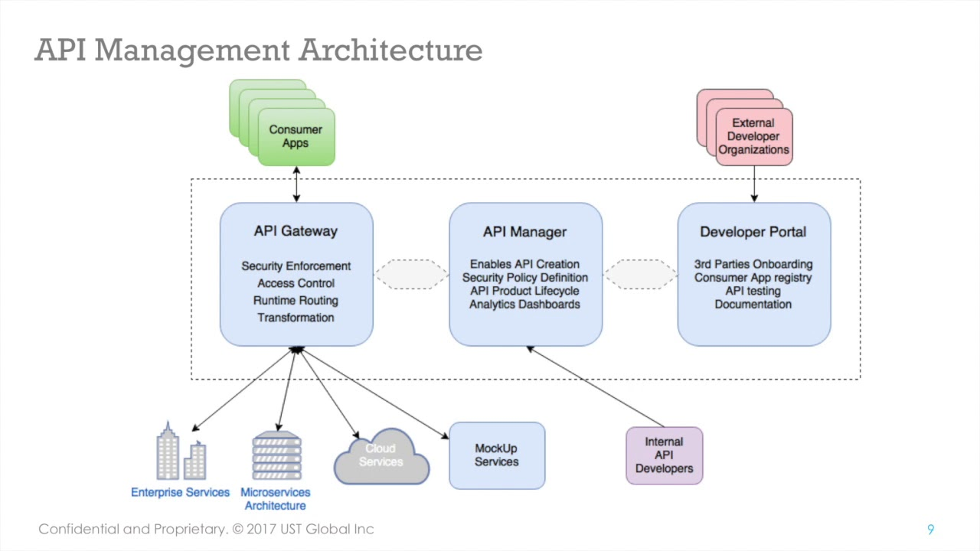
API services in IBM and AWS Cloud
IBM API Management on Cloud
By using the IBM API Management on Cloud solution, you can create, manage, and monitor a cloud-based environment from which you can create, promote, use, and track APIs.
Image Source: https://i.ytimg.com/vi/jzfZfVtl97c/maxresdefault.jpg
Notes:
Left (White Color space):
Title - Parent Topic
Subtitle - Subtopic 1
Body Text - Description in bullets
Right (Grey Color Space):
Body Text - Relevant image (with source)/code snippet
Put reference links in Speaker Notes
Reference:
https://www.tutorialspoint.com/internet_technologies/internet_overview.htm/

Slide 34
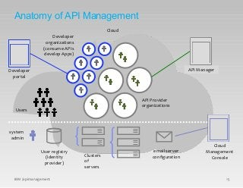
API services in IBM and AWS Cloud
Anatomy of the IBM API Management cloud
The IBM API Management cloud is a collection of servers that comprise an API Management installation, including the configuration information and metadata that they contain.
Image Source:https://image.slidesharecdn.com/iag-apimanagementarchitectpresentation-150804045154-lva1-app6891/85/iag-api-management-architect-presentation-30-320.jpg?cb=1438664051
Notes:
Left (White Color space):
Title - Parent Topic
Subtitle - Subtopic 1
Body Text - Description in bullets
Right (Grey Color Space):
Body Text - Relevant image (with source)/code snippet
Put reference links in Speaker Notes
Reference:
https://www.tutorialspoint.com/internet_technologies/internet_overview.htm/

Slide 35
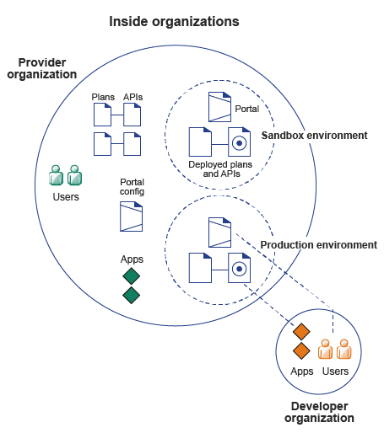
API services in IBM and AWS Cloud
Inside organizations
Signing up to IBM API Management on Cloud
Purchasing IBM API Management on Cloud
API Management on Cloud concepts
API Management on Cloud user roles
IBM API Management on Cloud software requirements
IBM API Management on Cloud support
Image Source: https://www.ibm.com/docs/en/SSZFB2_3.0.1/com.ibm.apimgmt.overview.doc/orgs.gif
Notes:
Left (White Color space):
Title - Parent Topic
Subtitle - Subtopic 1
Body Text - Description in bullets
Right (Grey Color Space):
Body Text - Relevant image (with source)/code snippet
Put reference links in Speaker Notes
Reference:
https://www.tutorialspoint.com/internet_technologies/internet_overview.htm/

Slide 36
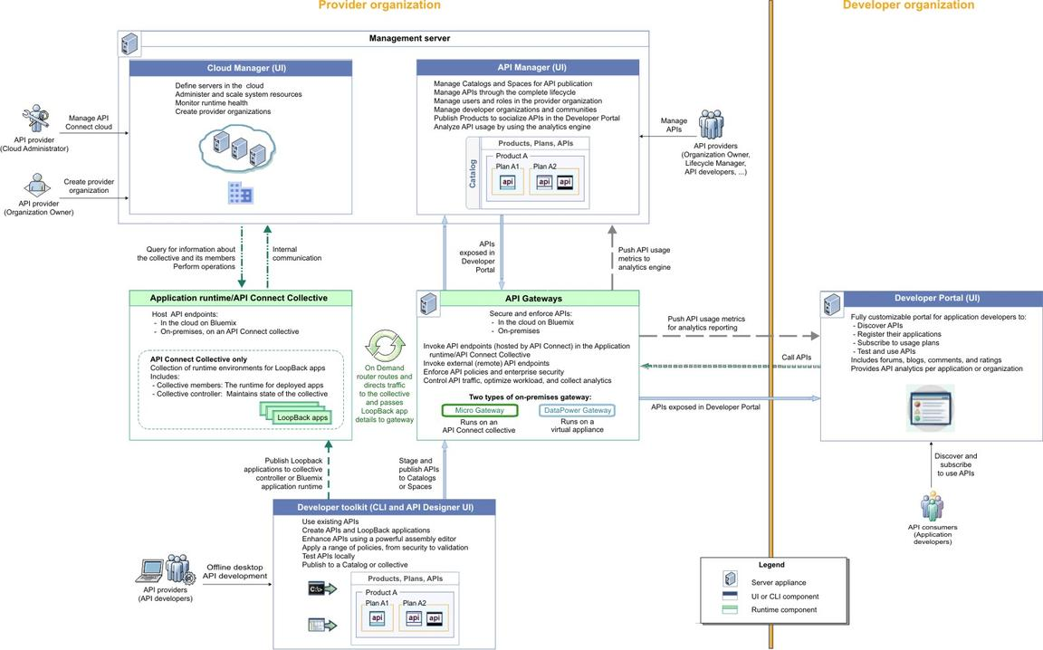
API services in IBM and AWS Cloud
API Connect components
Cloud Manager
The developer toolkit
API Manager
API Gateways
Runtime
Developer Portal
API Analytics
Typical tasks per interface component
API Connect server requirements
Image Source: https://cloudnative101.dev/static/c3d2babf42907f5d86eb3bdb41631d37/2e753/api-connect-components.jpg
Notes:
Left (White Color space):
Title - Parent Topic
Subtitle - Subtopic 1
Body Text - Description in bullets
Right (Grey Color Space):
Body Text - Relevant image (with source)/code snippet
Put reference links in Speaker Notes
Reference:
https://www.tutorialspoint.com/internet_technologies/internet_overview.htm/

Slide 37
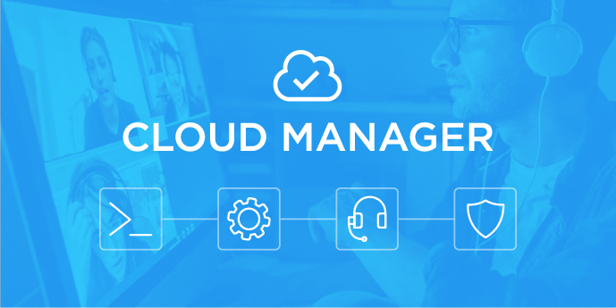
API services in IBM and AWS Cloud
Cloud Manager
The API Connect Cloud Manager component is used to manage the API Connect on-premises cloud.
Image Source: https://46svmh2eidr34ea1z715q5mm-wpengine.netdna-ssl.com/wp-content/uploads/10-ways.jpg
Notes:
Left (White Color space):
Title - Parent Topic
Subtitle - Subtopic 1
Body Text - Description in bullets
Right (Grey Color Space):
Body Text - Relevant image (with source)/code snippet
Put reference links in Speaker Notes
Reference:
https://www.tutorialspoint.com/internet_technologies/internet_overview.htm/

Slide 38

API services in IBM and AWS Cloud
The developer toolkit
The developer toolkit provides the tools for modeling, developing, and testing APIs and LoopBack® applications.
The developer toolkit includes a command line interface (CLI).
It also incorporates LoopBack, an open source Node.js framework.
Image Source: https://media.pocketgamer.biz/2020/8/106574/pgc-hsk-developer-toolkit-r225x.png
Notes:
Left (White Color space):
Title - Parent Topic
Subtitle - Subtopic 1
Body Text - Description in bullets
Right (Grey Color Space):
Body Text - Relevant image (with source)/code snippet
Put reference links in Speaker Notes
Reference:
https://www.tutorialspoint.com/internet_technologies/internet_overview.htm/

Slide 39
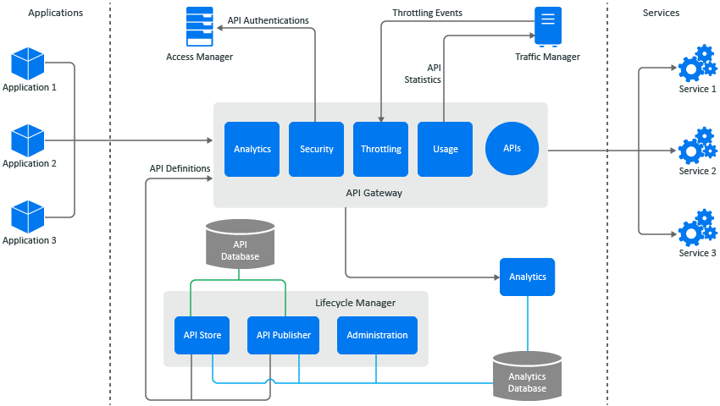
API services in IBM and AWS Cloud
API Manager
The API Manager provides a user interface that facilitates promotion and tracking of APIs that are packaged within Products and Plans.
API providers can move the Products through their lifecycle, and manage the availability and visibility of APIs and Plans.
Image Source: https://www.netiq.com/documentation/secure-api-manager-10/secure-api-manager-install/graphics/secure-api-manager-architecture-a.png
Notes:
Left (White Color space):
Title - Parent Topic
Subtitle - Subtopic 1
Body Text - Description in bullets
Right (Grey Color Space):
Body Text - Relevant image (with source)/code snippet
Put reference links in Speaker Notes
Reference:
https://www.tutorialspoint.com/internet_technologies/internet_overview.htm/

Slide 40
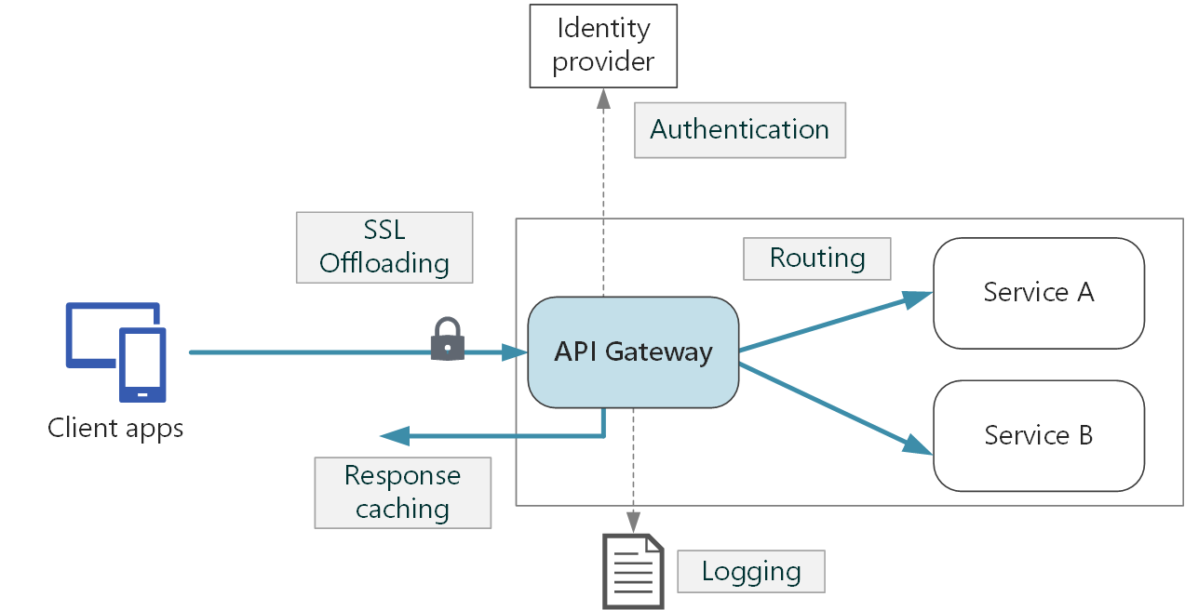
API services in IBM and AWS Cloud
API Gateways
Gateways enforce runtime policies to secure and control API traffic, provide the endpoints that expose APIs to the calling applications, and provide assembly functions that enable APIs to integrate with various endpoints.
Image Source: https://docs.microsoft.com/en-us/azure/architecture/microservices/images/gateway.png
Notes:
Left (White Color space):
Title - Parent Topic
Subtitle - Subtopic 1
Body Text - Description in bullets
Right (Grey Color Space):
Body Text - Relevant image (with source)/code snippet
Put reference links in Speaker Notes
Reference:
https://www.tutorialspoint.com/internet_technologies/internet_overview.htm/

Slide 41

API services in IBM and AWS Cloud
Developer Portal
The Developer Portal provides a customizable self-service web-based portal to application developers to explore, discover, and subscribe to APIs.
Image Source: https://marvel-b1-cdn.bc0a.com/f00000000156481/www.akana.com/sites/default/files/image/2019-06/image-blog-api-developer-portal-service-catalog-600x400.jpg
Notes:
Left (White Color space):
Title - Parent Topic
Subtitle - Subtopic 1
Body Text - Description in bullets
Right (Grey Color Space):
Body Text - Relevant image (with source)/code snippet
Put reference links in Speaker Notes
Reference:
https://www.tutorialspoint.com/internet_technologies/internet_overview.htm/

Slide 42
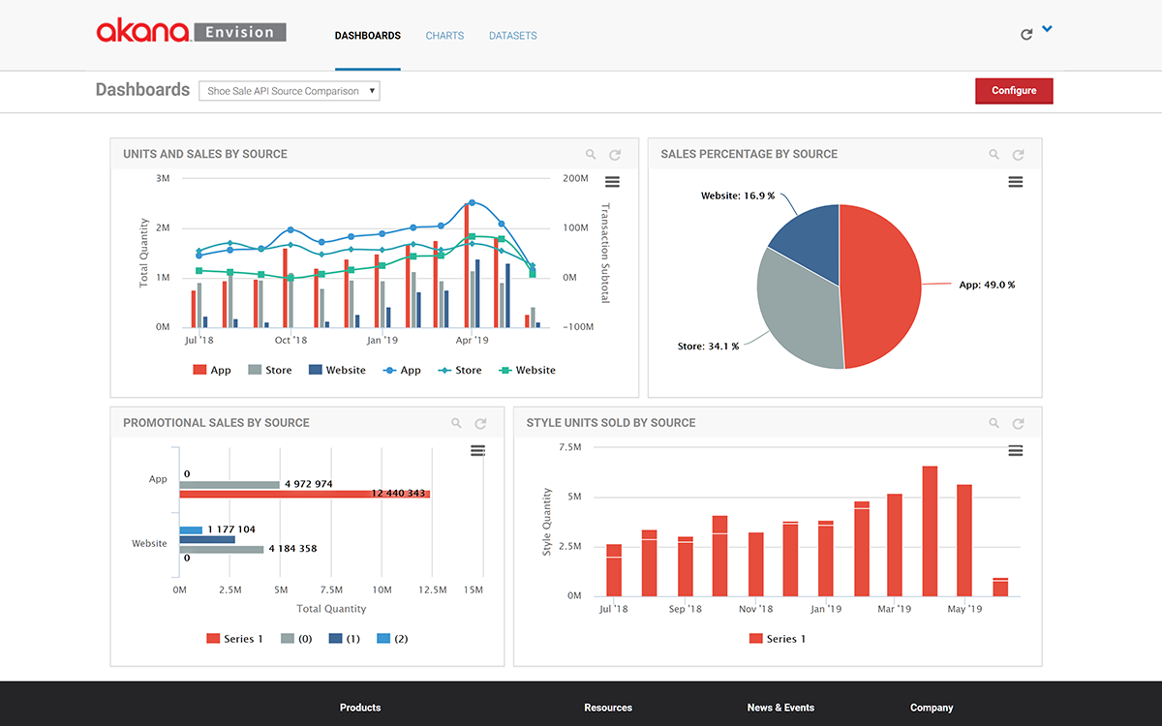
API services in IBM and AWS Cloud
API Analytics
API Connect provides the capability to filter, sort, and aggregate your API event data.
This data is then presented within correlated charts, tables, and maps, to help you manage service levels, set quotas, establish controls, set up security policies, manage communities, and analyze trends.
Image Source: https://www.akana.com/sites/default/files/image/2019-06/image-product-api-analytics-envision.png
Notes:
Left (White Color space):
Title - Parent Topic
Subtitle - Subtopic 1
Body Text - Description in bullets
Right (Grey Color Space):
Body Text - Relevant image (with source)/code snippet
Put reference links in Speaker Notes
Reference:
https://www.tutorialspoint.com/internet_technologies/internet_overview.htm/

Slide 43
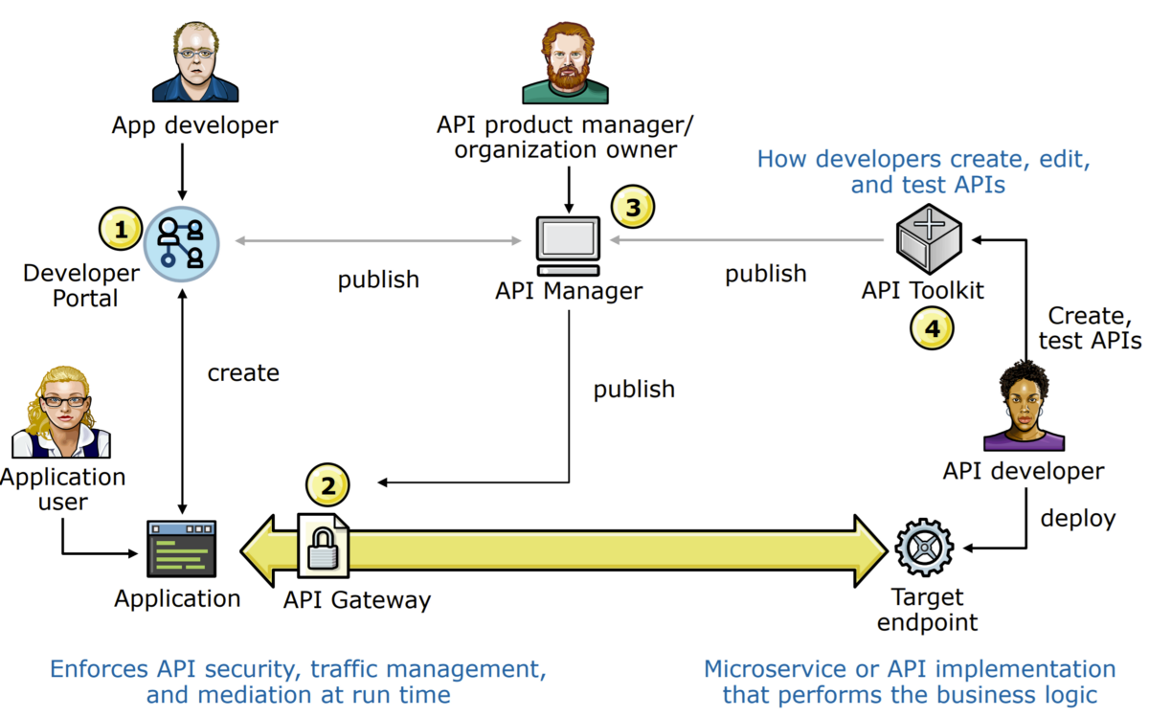
API services in IBM and AWS Cloud
API Connect server requirements
Management server
Analytics server
Gateway server
Developer Portal server
Image Source: https://miro.medium.com/max/1200/1*YwfeJz6V-4rNMDxTmg-jlw.png
Notes:
Left (White Color space):
Title - Parent Topic
Subtitle - Subtopic 1
Body Text - Description in bullets
Right (Grey Color Space):
Body Text - Relevant image (with source)/code snippet
Put reference links in Speaker Notes
Reference:
https://www.tutorialspoint.com/internet_technologies/internet_overview.htm/

Slide 44
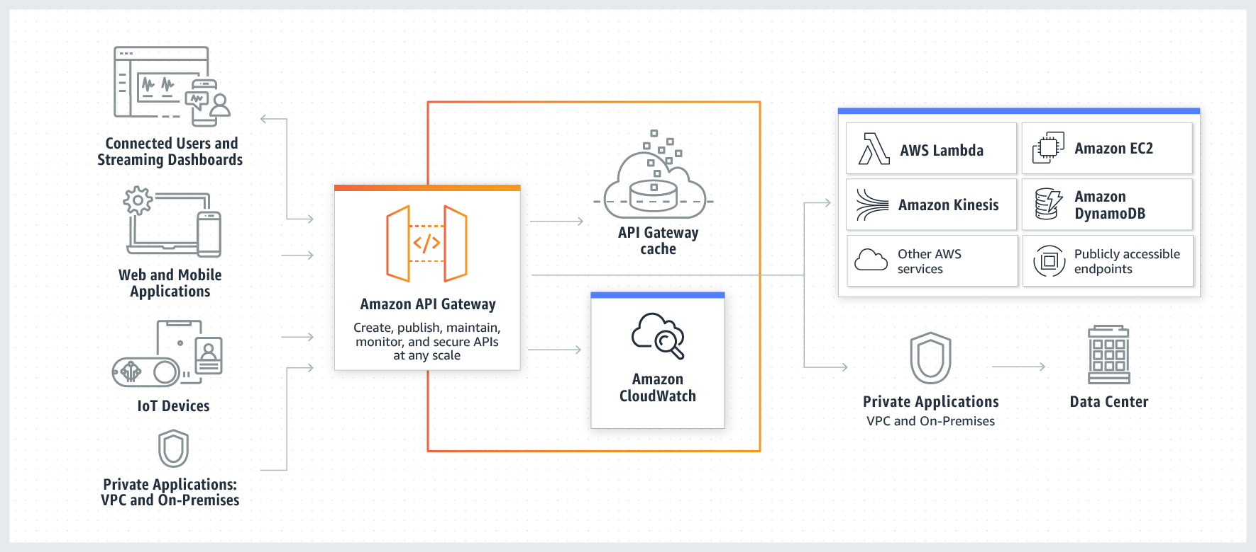
API services in IBM and AWS Cloud
API management tools on AWS
AWS offers a comprehensive platform for API management called Amazon API Gateway.
Used across businesses and organizations, from enterprises to startups, API Gateway makes it easy to define, secure, deploy, share, and operate APIs at any scale.
Image Source: https://d1.awsstatic.com/serverless/New-API-GW-Diagram.c9fc9835d2a9aa00ef90d0ddc4c6402a2536de0d.png
Notes:
Left (White Color space):
Title - Parent Topic
Subtitle - Subtopic 1
Body Text - Description in bullets
Right (Grey Color Space):
Body Text - Relevant image (with source)/code snippet
Put reference links in Speaker Notes
Reference:
https://www.tutorialspoint.com/internet_technologies/internet_overview.htm/

Slide 45
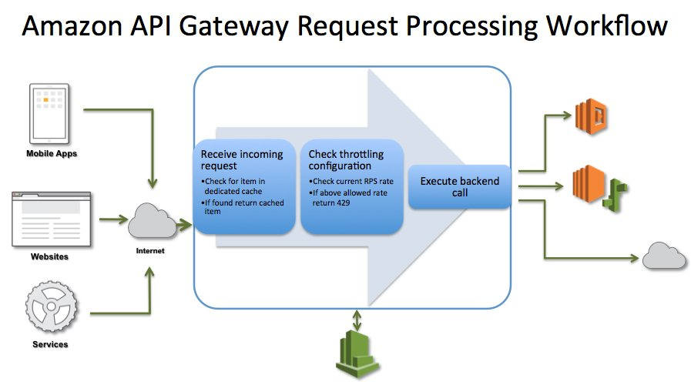
API services in IBM and AWS Cloud
Amazon API Gateway benefits
A security-first approach for API Management.
API Management tools for building and deploying APIs.
API Management tolls for hands-off scaling and complete operational visibility.
API Management tools for third-party access.
Image Source: https://thenewstack.io/wp-content/uploads/2015/07/image01.jpg
Notes:
Left (White Color space):
Title - Parent Topic
Subtitle - Subtopic 1
Body Text - Description in bullets
Right (Grey Color Space):
Body Text - Relevant image (with source)/code snippet
Put reference links in Speaker Notes
Reference:
https://www.tutorialspoint.com/internet_technologies/internet_overview.htm/

Slide 46

API services in IBM and AWS Cloud
API management on AWS: Customer case studies
Fox Digital Entertainment Group uses a common API layer powered by Amazon API Gateway to build and deliver FOX NOW, an application that streams millions of hours of digital content to consumers across devices.
Image Source: https://d1.awsstatic.com/serverless/Fox-logo.bafd14abfae20da112b5ac01698769129fc9a2fd.png
Notes:
Left (White Color space):
Title - Parent Topic
Subtitle - Subtopic 1
Body Text - Description in bullets
Right (Grey Color Space):
Body Text - Relevant image (with source)/code snippet
Put reference links in Speaker Notes
Reference:
https://www.tutorialspoint.com/internet_technologies/internet_overview.htm/

Slide 47

API services in IBM and AWS Cloud
API management on AWS: Customer case studies
The UK Driver and Vehicle Licensing Agency took an API-first approach to meet their exponentially increasing demand for information requests after switching to a digital means of excise-tax payment.
By using Amazon API Gateway, the only thing they worry about is the code—the thing that creates the greatest value—and everything else is taken care of.
Image Source:https://d1.awsstatic.com/serverless/UK-driver-and-licensing-agency-logo.8411dc3ddc681afaded0332dedc2583c40a381e0.png
Notes:
Left (White Color space):
Title - Parent Topic
Subtitle - Subtopic 1
Body Text - Description in bullets
Right (Grey Color Space):
Body Text - Relevant image (with source)/code snippet
Put reference links in Speaker Notes
Reference:
https://www.tutorialspoint.com/internet_technologies/internet_overview.htm/

Slide 48
API services in IBM and AWS Cloud
Benefits of AWS
Massive scalability to support billions of transactions per month
Elastic scaling to meet widely variable demand
Flexibility to throttle transaction volumes to support hybrid architectu
Security and governance capabilities meeting rigorous government standards
Reduced cost and increased agility with serverless computing
Image Source:https://d1.awsstatic.com/serverless/UK-driver-and-licensing-agency-logo.8411dc3ddc681afaded0332dedc2583c40a381e0.png
Notes:
Left (White Color space):
Title - Parent Topic
Subtitle - Subtopic 1
Body Text - Description in bullets
Right (Grey Color Space):
Body Text - Relevant image (with source)/code snippet
Put reference links in Speaker Notes
Reference:
https://www.tutorialspoint.com/internet_technologies/internet_overview.htm/

